Slide 1
Amplitude Modulation

Slide 2
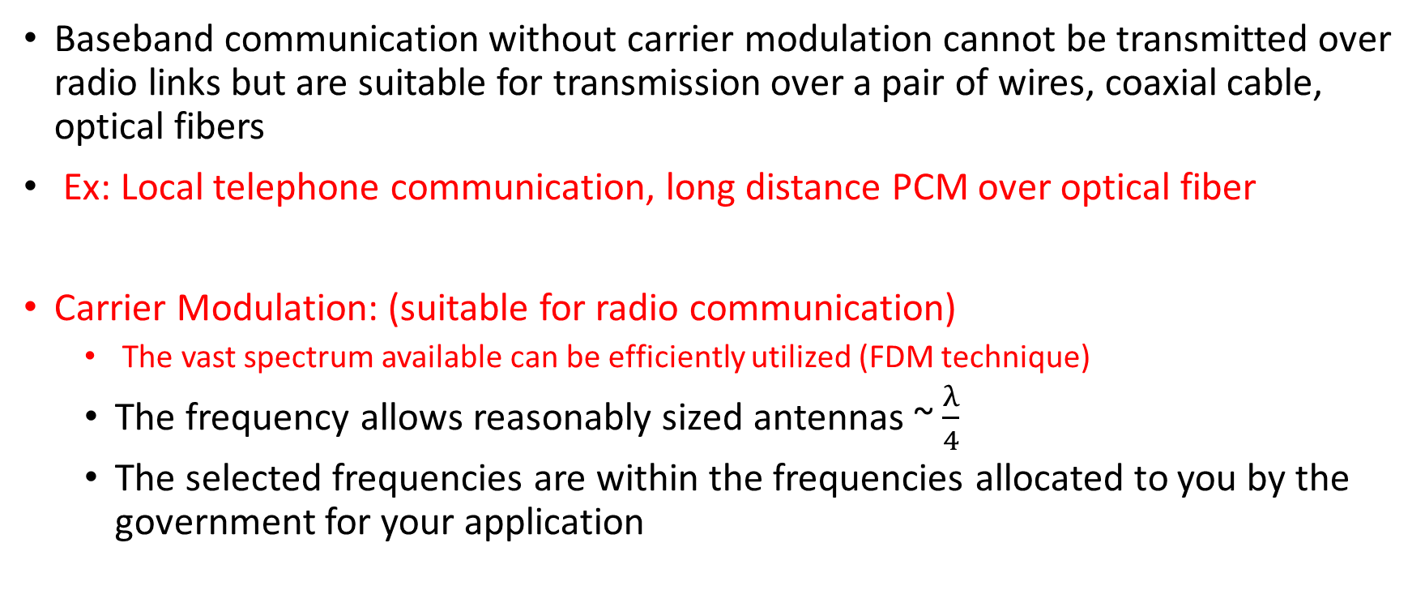
Why carrier modulation?
Baseband communication without carrier modulation cannot be transmitted over radio links but are suitable for transmission over a pair of wires, coaxial cable, optical fibers
Ex: Local telephone communication, long distance PCM over optical fiber
Carrier Modulation: (suitable for radio communication)
The vast spectrum available can be efficiently utilized (FDM technique)
The frequency allows reasonably sized antennas ~ $\frac{λ}{4}$
The selected frequencies are within the frequencies allocated to you by the government for your application

Slide 3
Analog communication techniques: why?
Why bother?
After all, the world is going digital
Modern communication system designers focused mainly on DSP algorithms for digital communication.
But need to understand the underlying physical analog signals
Establishes common language with circuit designers
Analog-centric techniques become critical when pushing the limits of carrier frequency, bandwidth and/or power consumption
Focus of these techniques is on baseband to passband conversion, and back

Slide 4
Amplitude modulation
DSB: encode info in I component
Uses twice the bandwidth it really needs
Requires carrier sync for demodulation
Conventional AM
Modifies DSB to eliminate carrier sync requirement at the expense of power efficiency
SSB/VSB
More efficient bandwidth usage than DSB
Requires carrier sync for demodulation
Can be modified to eliminate carrier sync requirement at the expense of power efficiency

Slide 5
Key concepts
Two ways of encoding info in complex envelope
I and Q ➔ amplitude modulation (several variants)
Envelope and phase ➔ angle modulation (constant envelope)
Up/down conversion
Multiple stages or single stage (superheterodyne or direct conversion)
Phase locked loop
Feedback-based synchronization and tracking

Slide 6
Terminology
Message Signal: The analog baseband message signal is denoted by m(t). Any message we would encounter in practice would have finite energy (time-limited signal).
When modelling transmissions over long time intervals, it is useful to think of messages as finite power signals spanning an infinite time interval.
Since we consider physical message signals, the time domain signal is real valued, so that its Fourier transform (defined for a finite energy signal) is conjugate symmetric:
M(f) = M∗(−f).

Slide 7


Terminology
Finite-power sinusoidal message signal,
m(t) = A_{m} cos(2πf_{m}t), whose spectrum consists of impulses at ±f_{m}:
M(f) = (A_{m}/2) (δ(f − f_{m}) + δ(f + f_{m})).
DC value of m(t)
Power of m(t)

Slide 8
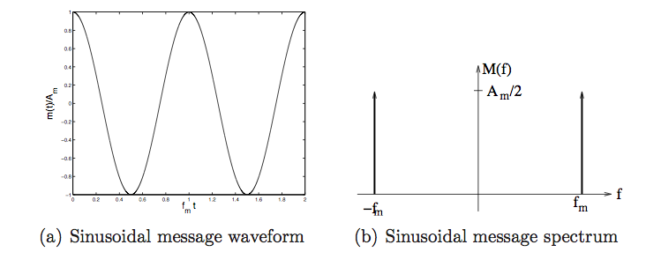
A sinusoidal message

Slide 9


Transmitted Signal: I and Q Components
When the signal transmitted over the channel is a passband signal
where f_{c} is a carrier frequency, u_{c} (t) is the inphase (I) component, u_{s}(t) is the quadrature (Q) component, e(t) ≥ 0 is the envelope, and θ(t) is the phase. Modulation consist of encoding the message in u_{c}(t) and u_{s}(t), or equivalently, in e(t) and θ(t), where

Slide 10
In most of the analog amplitude modulation schemes considered, the message modulates the I component.
The exception is quadrature amplitude modulation, in which both I and Q components carry separate messages.
In phase and frequency modulation, or angle modulation, the message directly modulates the phase θ(t) or its derivative, keeping the envelope e(t) unchanged.

Slide 11
Double-Sideband Suppressed Carrier (DSB-SC)
The message m(t) modulates the I component of the passband transmitted signal u(t) as follows:
u_{DSB}(t) = Am(t) cos(2πf_{c}t)
Taking Fourier transforms, we have
U_{DSB}(f) =A/2 (M(f − f_{c}) +M(f + f_{c}))

Slide 12
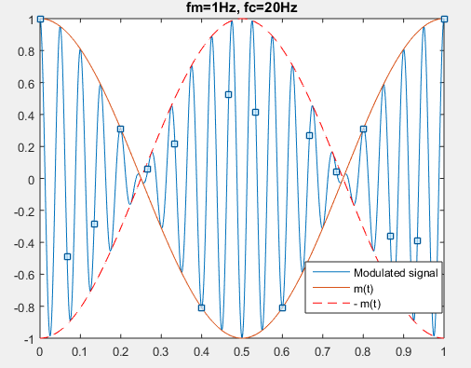
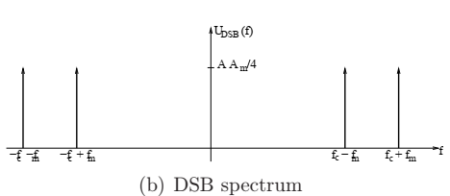
DSB-SC signal Am(t) cos(2πf_{c}t) for m(t)= A_{m} cos(2πf_{m}t)

Slide 13
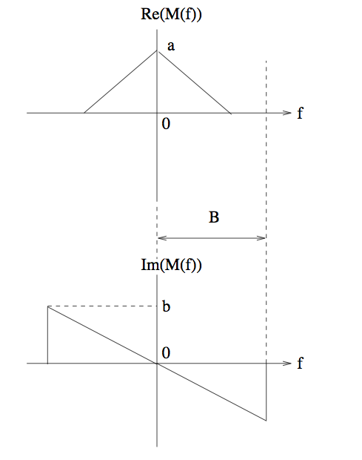
A more interesting example
Consider the finite-energy message. Since the time domain message m(t) is real-valued, its spectrum exhibits conjugate symmetry.

Slide 14
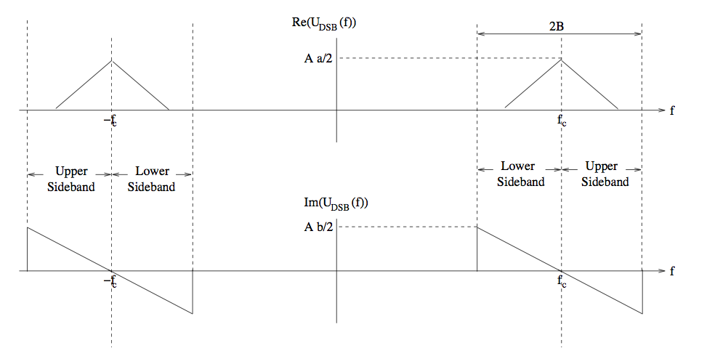
DSB spectrum

Slide 15
DSB-SC Spectrum
The message bandwidth is denoted by B. The bandwidth of the DSB-SC signal is 2B, which is twice the message bandwidth.
The shape of the signal in the USB (i.e., U_{p}(f) for f_{c} < f ≤ f_{c} + B) is the same as that of the message for positive frequencies (i.e., M(f), f > 0).
The shape of the signal in the LSB (i.e., U_{p}(f) for f_{c} − B ≤ f < f_{c}) is the same as that of the message for negative frequencies (i.e., M(f), f < 0).

Slide 16
Sideband Information
Since m(t) is real-valued, we have M(−f) = M∗(f)
Then, Re(M(f)) is even and Im(M(f)) is odd.
Thus, the USB and LSB of u(t) each contain enough information to reconstruct the message.
The term DSB refers to the fact that we are sending both sidebands. Doing this, of course, is wasteful of spectrum. This motivates single sideband (SSB) and vestigial sideband (VSB) modulation.
The term suppressed carrier is employed because, for a message with no DC component, the transmitted signal does not have a discrete component at the carrier frequency (i.e., U_{p}(f) does not have impulses at ±f_{c}).

Slide 17
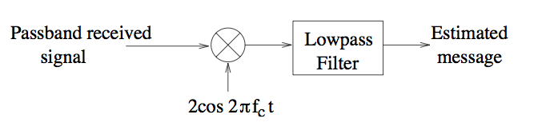


Demodulation of DSB-SC
Standard down-converter to recover I component
In the presence of carrier phase offset
Passband received signal, with
phase offset wrt local carrier at RX

Slide 18

The output of the demodulator after LPF
I component extracted by down-converter
Message gets attenuated due to phase offset

Slide 19
Phase Mismatch Problem
θ_{r} is the phase of the received carrier relative to the local copy of the carrier produced by the receiver’s local oscillator (LO).
For the demodulator to work well, we must have θ_{r} as close to zero as possible; that is, the carrier produced by the LO must be coherent with the received carrier. The signal gets significantly attenuated as the phase mismatch increases, and gets completely wiped out for θ_{r} = π/2 .
Phase synchronization is absolutely essential for coherent demodulation!

Slide 20
Sidestepping Sync. Requirement
The envelope (or magnitude of complex envelope) does not depend on carrier phase
Suppose we can extract the envelope of a passband signal (using a simple circuit)
Does not require carrier sync
Can we recover the message?

Slide 21
DSB-SC waveform

Slide 22
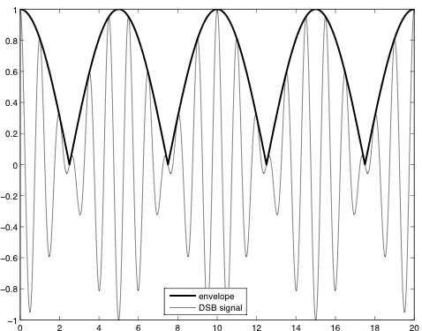
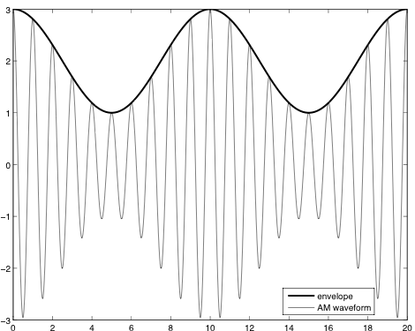
What does the envelope tell us?
Example: sinusoidal message waveform
DSB signal
Envelope = message magnitude
➔ Envelope detection loses info
in message sign
DSB signal + strong carrier component
Envelope = message + DC
Envelope detector + DC block
recovers message info

Slide 23
Amplitude Modulation (AM)
In conventional AM, we add a large carrier component to a DSB-SC signal, so that the pass-band transmitted signal is of the form:
u_{AM}(t) = A m(t) cos(2πf_{c}t) + A_{c} cos(2πf_{c}t)
Taking the Fourier transform,
U_{AM}(f) = A/2(M(f − f_{c}) +M(f + f_{c})) + A_{c}/2(δ(f − f_{c}) + δ(f + f_{c}))

Slide 24
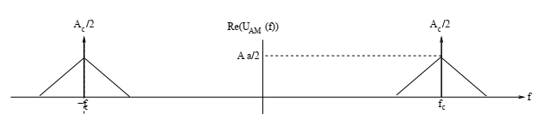
AM Signal
In addition to the USB and LSB due to the message modulation, we also have impulses at ±f_{c} due to the unmodulated carrier.
The key concept behind conventional AM is that, by making A_{c} large enough, the message can be demodulated using a simple envelope detector.

Slide 25



Conventional AM
Add strong carrier component to DSB signal
AM spectrum
Envelope of AM signal
Condition needed for envelope to preserve message info
Can be expressed in terms of modulation index

Slide 26
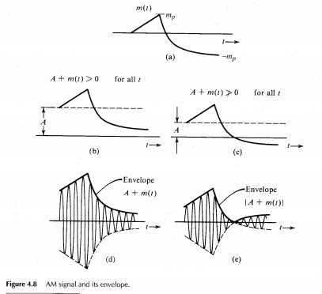

Slide 27

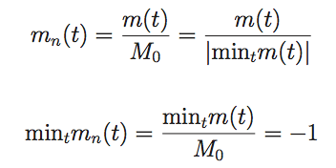


Modulation Index, $a_{mod}$
Should be smaller than one for envelope detection
Convenient to normalize message so largest negative swing is -1
AM signal expressed in terms of modulation index and normalized message

Slide 28
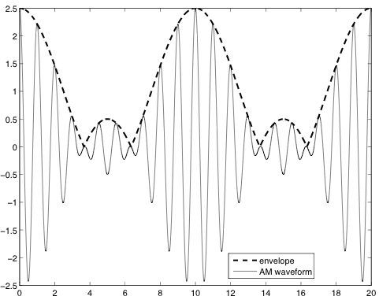
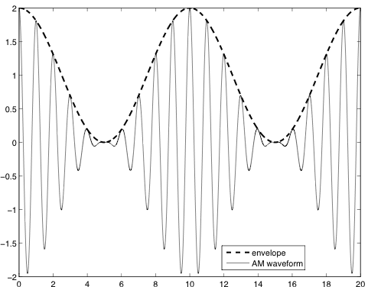
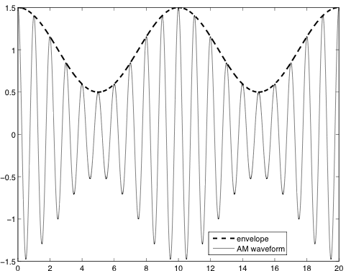
Effect of modulation index
Example of sinusoidal message
Envelope = message + DC
Envelope = message
Message info not preserved
in envelope

Slide 29
Demodulation of Conventional AM
The received signal is given by
y_{p}(t) = B (1 + a_{mod}m_{n}(t)) cos(2πf_{c}t + θ_{r})
where θ_{r} is a phase offset which is unknown a priori. As long as a_{mod} ≤ 1, we can recover the message without knowing θ_{r} using envelope detection, since the envelope is still just a scaled and DC-shifted version of the message.
The envelope detector is shown next. The diode (ideal) conducts in only the forward direction, when the input voltage v_{in}(t) of the passband signal is larger than the output voltage v_{out}(t) across the RC filter. When this happens, the output voltage becomes equal to the input voltage instantaneously.
When the input voltage is smaller than the output voltage, the diode does not conduct, and the capacitor starts discharging through the resistor with time constant RC.

Slide 30
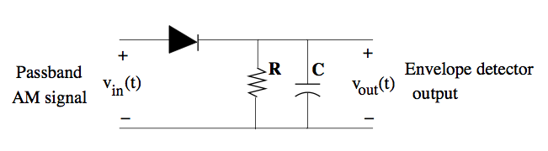
How do we do envelope detection?
Positive carrier cycle ➔ capacitor charges up (reaches value of envelope)
Negative carrier cycle ➔ capacitor discharges with RC time constant

Slide 31
Envelope Detection
The capacitor gets charged at each carrier peak, and discharges between peaks. The time interval between successive charging episodes is therefore approximately equal to 1/fc, the time between successive carrier peaks.
The factor by which the output voltage is reduced during this period due to capacitor discharge is exp(−1/(f_{c}RC)). This must be close to one in order for the voltage to follow the envelope, rather than the variations in the sinusoidal carrier.
The decay in the envelope detector output must be fast enough (i.e., the RC time constant must be small enough) so that it can follow changes in the envelope. Since the time constant for envelope variations is inversely proportional to the message bandwidth B, we must have RC ≪ 1/B. Combining these two conditions for envelope detection to work well, we have
1/fc ≪ RC ≪1/B

Slide 32
Envelope Detector
This requires that fc ≫ B (carrier frequency much larger than message bandwidth). E. g., the carrier frequencies in broadcast AM radio are over 500 KHz, whereas the message bandwidth is limited to 5 KHz.
The RC time constant for an envelope detector should be chosen so that
2 μs ≪ RC ≪ 200 μs
For RC = 20μs, for example, with R = 50 ohms, and C = 400 nF.

Slide 33
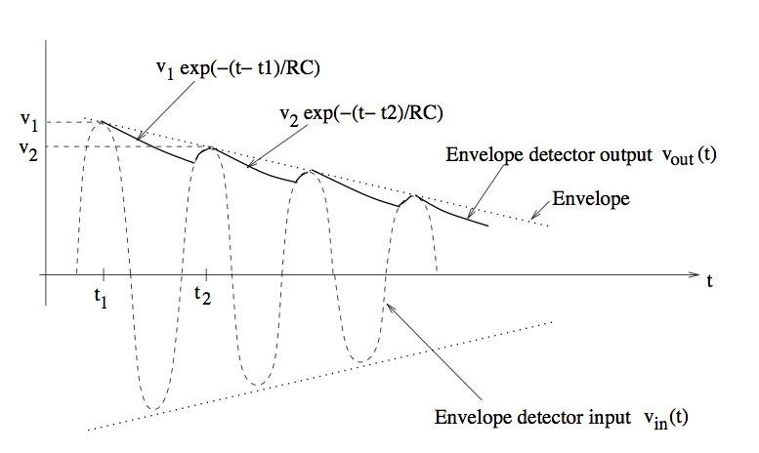
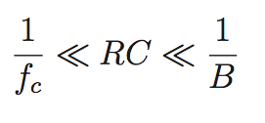
Envelope detector operation
Positive carrier cycle ➔ capacitor charges up (reaches value of envelope)
Negative carrier cycle ➔ capacitor discharges with RC time constant
Should not discharge too fast during negative cycle
Should react fast enough to follow variations in envelope
(which depend on message bandwidth B)

Slide 34





Power efficiency
Power of AM signal
0 (DC component of
passband signal at 2f_{c}
Power of message bearing component of AM signal
Power efficiency

Slide 35
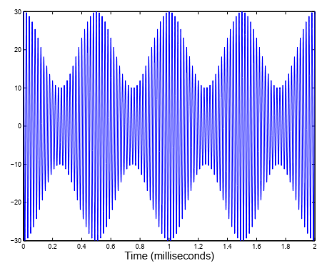
Example
Problem 3.1 Figure shows a signal obtained after amplitude modulation by a sinusoidal message. The carrier frequency is difficult to determine from the figure, and is not needed for answering the questions below.
(a) Find the modulation index.
(b) Find the signal power.
(c) Find the bandwidth of the AM signal.

Slide 36
Example power efficiency computation

Slide 37
Example power efficiency computation
Need to find minimum of message and then normalize by its magnitude to get m_{n}
Suffices to minimize
Can minimize numerically (over a period) or analytically to get
➔

Slide 38

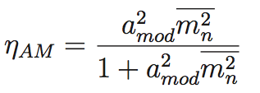
Power efficiency computation (contd)
=0.24 for a_{mod}=0.7

Slide 39
Example

